Slide 1

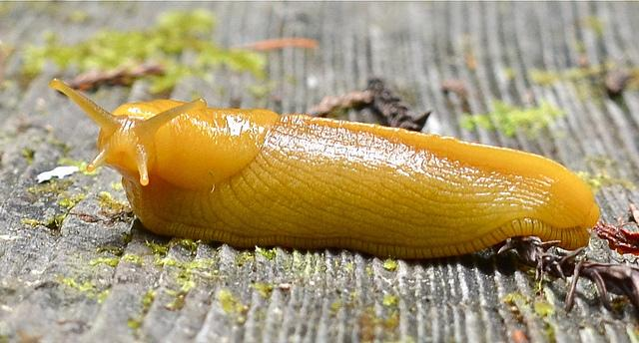
SlugStock
March 9 2016
Group 14
Dustin Bryan: Team Leader
James Brower
Trevor Barnes
Aramis Marden
Peter Greer-Berezovsky
Aramissd

Slide 2
Introduction to the problem
Organizing stock information can be a hassle
Most people manually monitor all of their stocks to make sure nothing is going wrong
Would be nice if you could be automatically informed when something drastic happens to your stocks

Slide 3
Goals
Be able to follow and view stocks in one convenient place
Receive automatic emails and SMS messages when stock prices cross user defined boundaries
Receive daily email digest of followed stocks
Display graphs for each stock (day, week, month etc.)
Be able to write notes associated with followed stocks

Slide 4
Achieved
All features are completed except for charts
Layout of site is still basic, UI and charts still a work in progress.

Slide 5
Challenges
Learning web2py
Using scheduler to perform tasks at defined intervals and times of day
Getting real time data through Yahoo finance API
Improving page load times using scheduler and ajax
Hosting on pythonanywhere brought some inconveniences

Slide 6
Technologies used
Management Techniques
web2py
Yahoo Finance API
Python
HTML
CSS
JavaScript
SQLite
Github
Google Hangouts
Open Communication
Scrum
Meetings

Slide 7
Things we...
Enjoyed:
Determining priorities as a team and planning appearance of site
Using web2py, it was very straightforward
Didn’t Enjoy:
Scheduling conflicts that pushed collaboration to weekends

Slide 8
Lessons Learned
What Worked:
Dividing user stories into lots of tasks usually made it clear what amount of effort would be necessary
Using Google Hangouts to keep in touch
Getting together on weekends to get stuff done

Slide 9
Lessons Learned
What Didn’t Work:
Putting off front end development until near the end
Burnup chart didn’t seem necessary, we generally knew if we were on track

